Slide 1
Those who tell stories rule the world
Native American proverb - https://www.linkedin.com/pulse/20140905114748-7374576-ted-those-who-tell-the-stories-rule-the-world/

Slide 2
Storytelling is the oldest form of education
Terry Tempest Williams

Slide 3
Who is your
Audience?

Slide 4
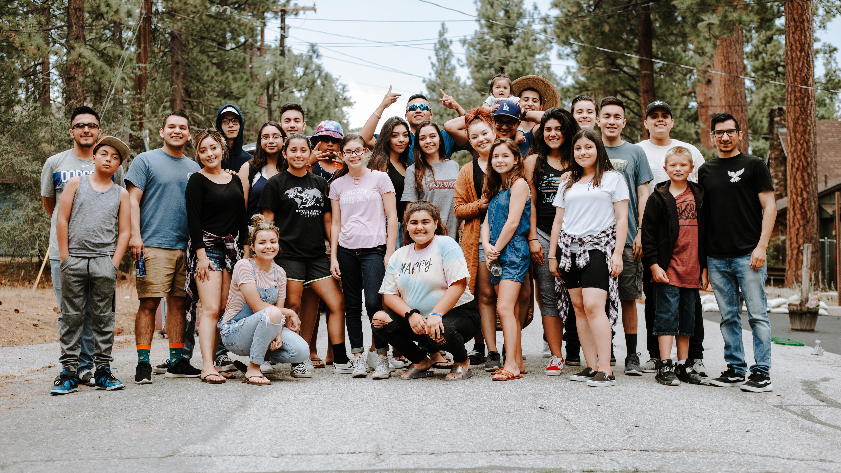
Notes:
Photo by Omar Lopez on Unsplash

Slide 5

Notes:
Photo by Philippe Leone on Unsplash

Slide 6
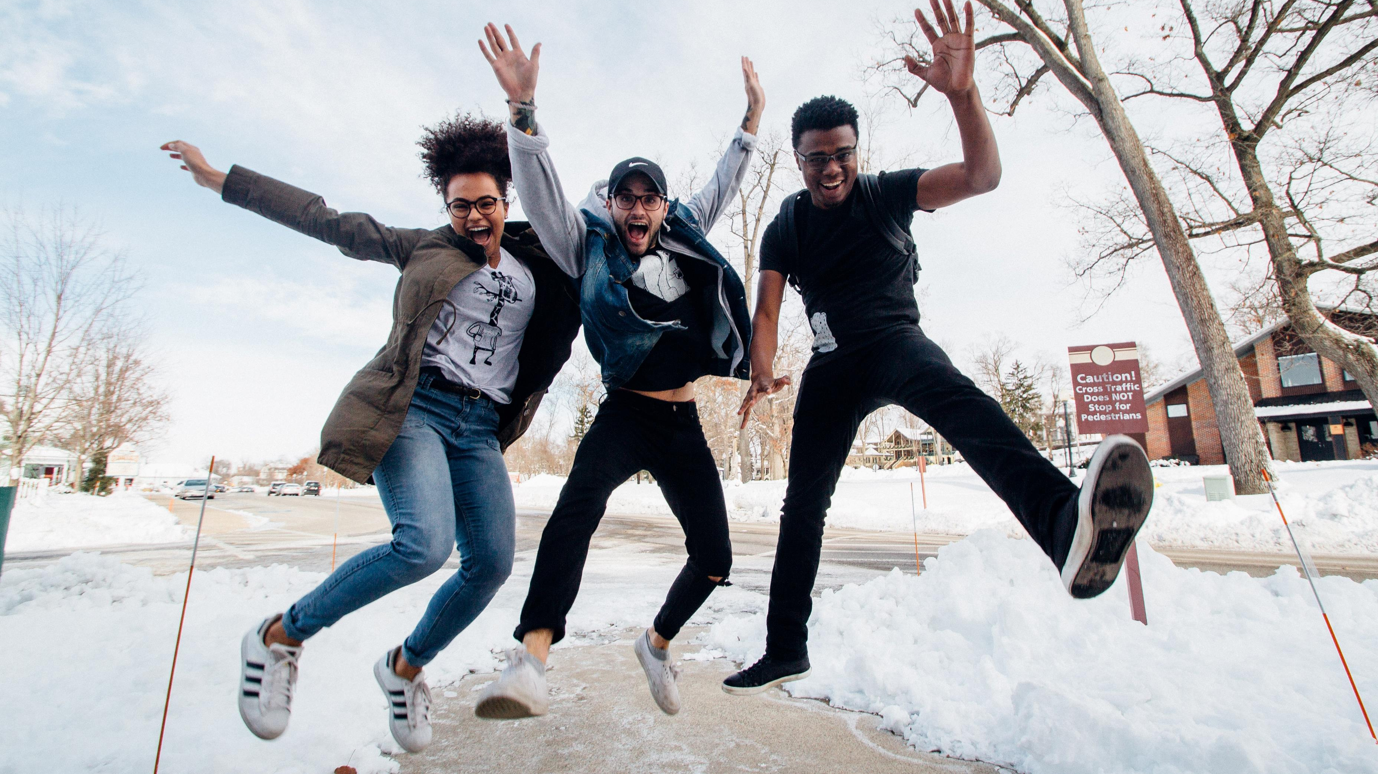
Notes:
Photo by Zachary Nelson on Unsplash

